Slide 1
Cresheim Valley Drive Sewer Project
Sewer Reconstruction; PWD Project # S-41132-R
March 2022 Update
Contractor: C. Abbonizio Construction
PWD Construction Engineer: Shyam Thomas

Slide 2
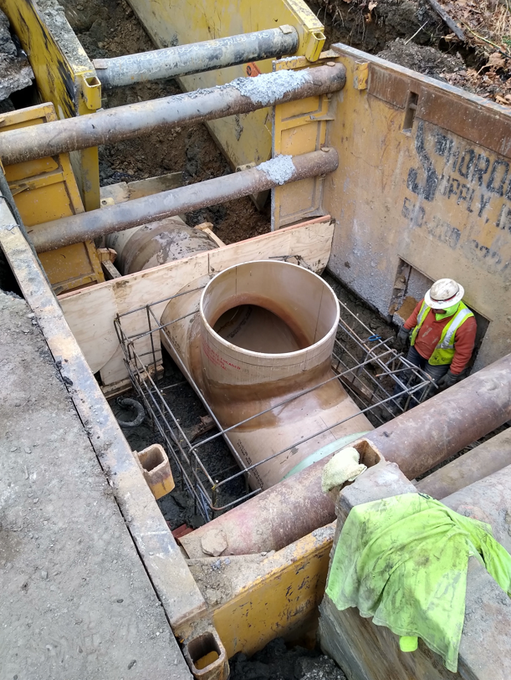
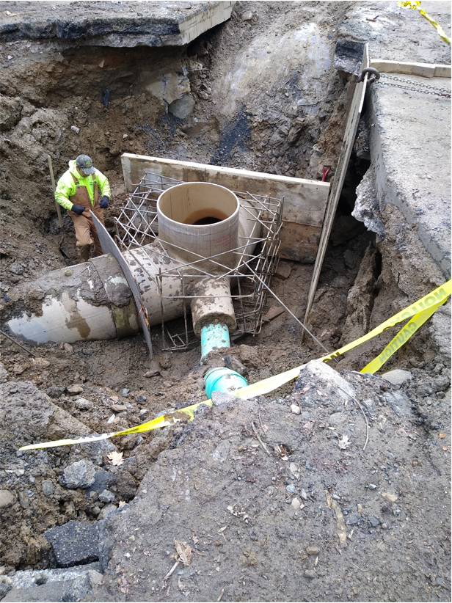
PHILADELPHIA WATER DEPARTMENT | Cresheim Interceptor Capacity Improvement

Slide 3
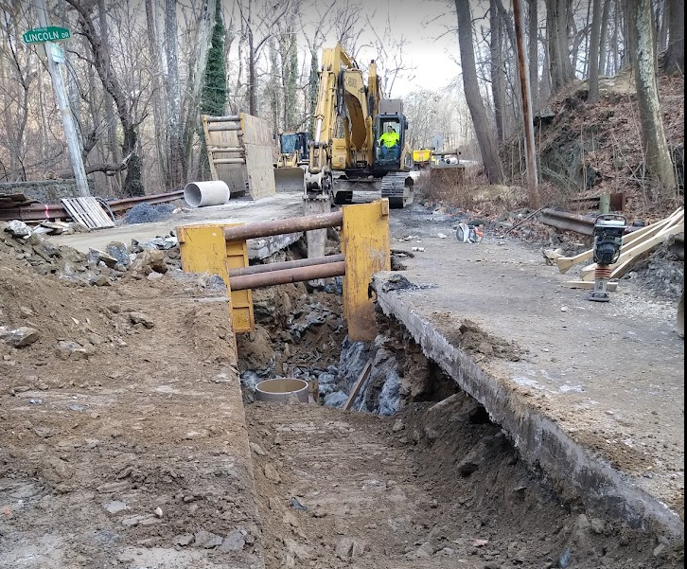
PHILADELPHIA WATER DEPARTMENT | Cresheim Interceptor Capacity Improvement

Slide 4
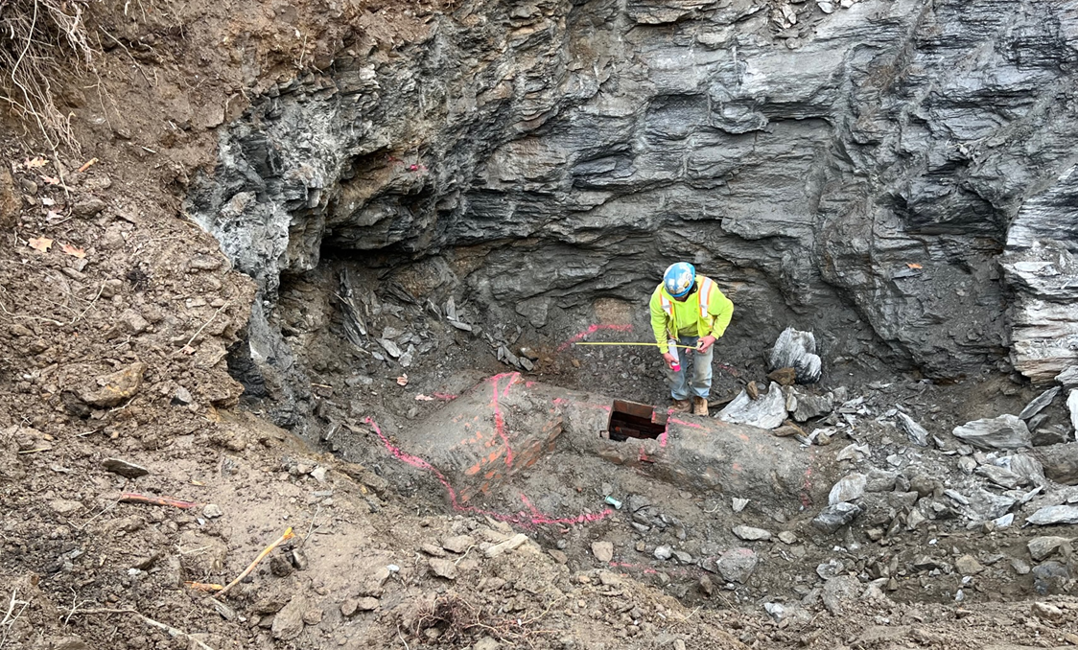
PHILADELPHIA WATER DEPARTMENT | Cresheim Interceptor Capacity Improvement

Slide 5
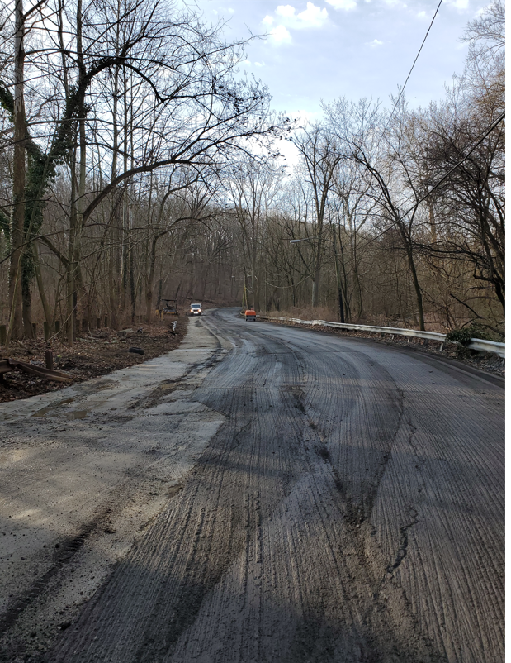
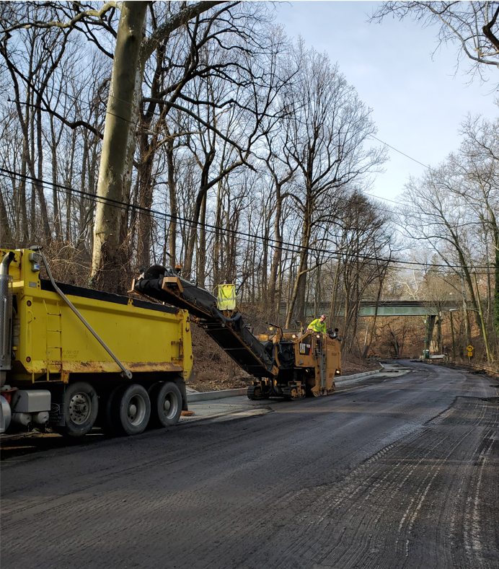
PHILADELPHIA WATER DEPARTMENT | Cresheim Interceptor Capacity Improvement

Slide 6
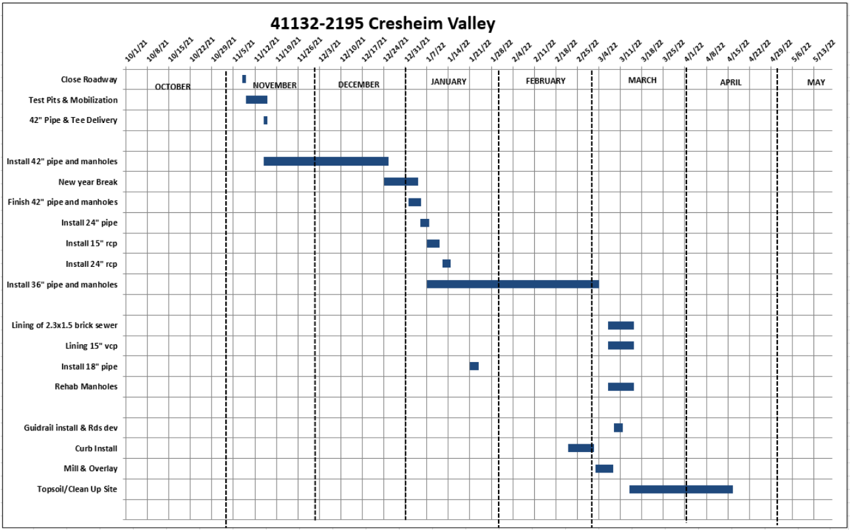
+ Traffic Safety Improvements
PHILADELPHIA WATER DEPARTMENT | Cresheim Interceptor Capacity Improvement

Slide 7
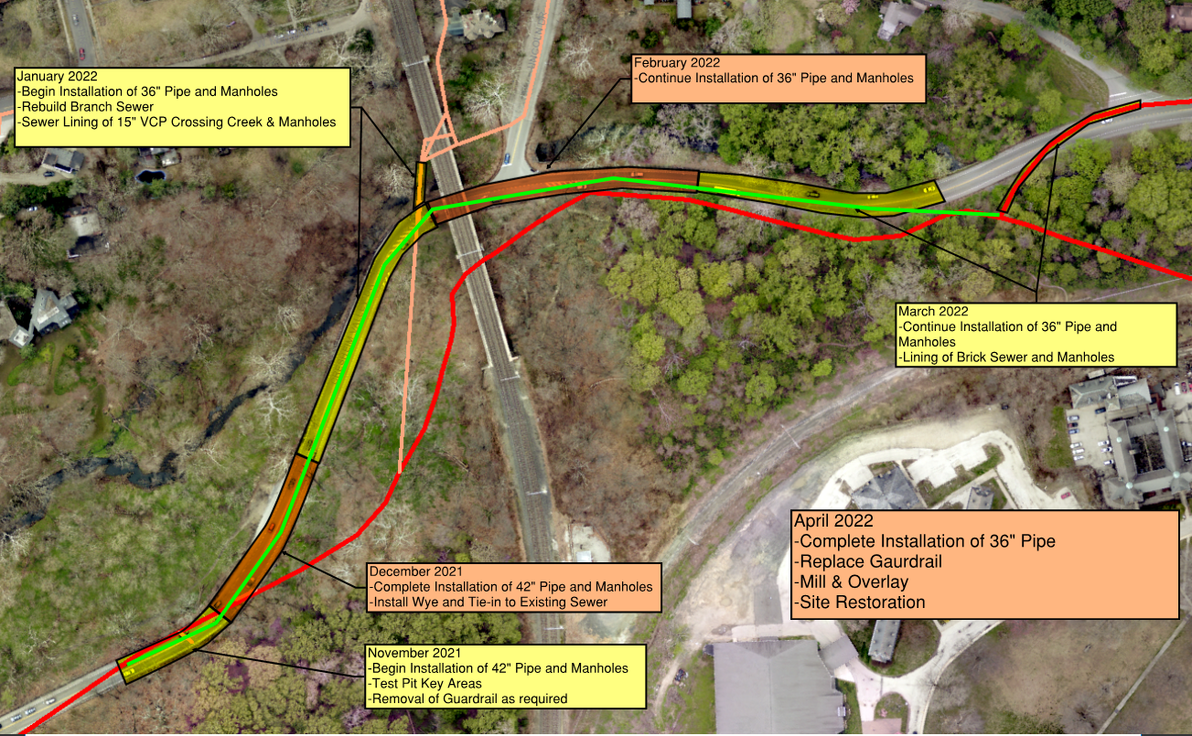
Construction Sequence & Schedule
+ Add’l Roadway Safety Measures
PHILADELPHIA WATER DEPARTMENT | Cresheim Interceptor Capacity Improvement

Slide 8
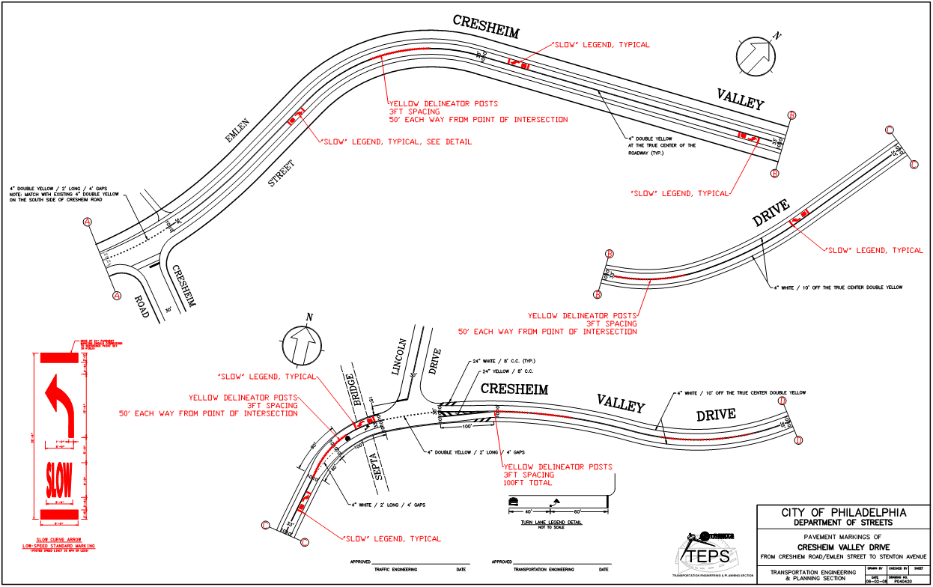
Cresheim Valley Drive - Traffic Safety Improvements
PHILADELPHIA WATER DEPARTMENT | Cresheim Interceptor Capacity Improvement
Notes:
Full Closure of Cresheim Valley Drive will be required; PWD does not take this lightly and made several considerations in the project design with intent to minimize duration of the project, and therefore, the impact to the community.
The extent of the excavation and space limitations led us to conclude that the work cannot be undertaken safely without full closure of the road.
Existing traffic conditions are not ideal from a safety perspective and are only exacerbated by construction conditions
Motorist sight lines are limited and cars appear suddenly at many locations on the drive due the sharp curvatures of the road

Slide 9
PHILADELPHIA WATER DEPARTMENT | Cresheim Interceptor Capacity Improvement

Slide 10
PHILADELPHIA WATER DEPARTMENT | Cresheim Interceptor Capacity Improvement

Slide 11
PHILADELPHIA WATER DEPARTMENT | Cresheim Interceptor Capacity Improvement

Slide 12
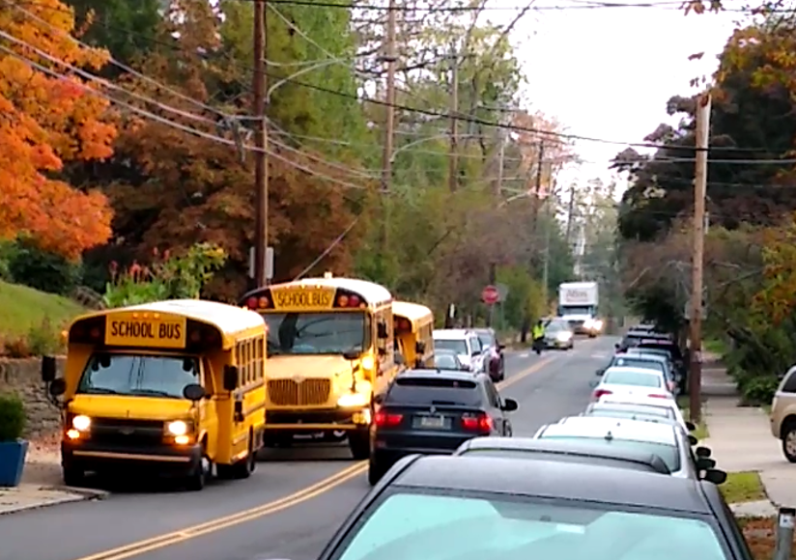
Henry Houston Elementary
Streets Dept, Community Members, State Reps, and PWD Met at School on Feb 9th
Police Presence Provided to Help Ensure Student Safety at Pick-Up and Drop-Off Times
School Dismissal Schedule Provided to PPD
PWD Construction Staff in Correspondence with School Personnel
PHILADELPHIA WATER DEPARTMENT | Cresheim Interceptor Capacity Improvement

Slide 13
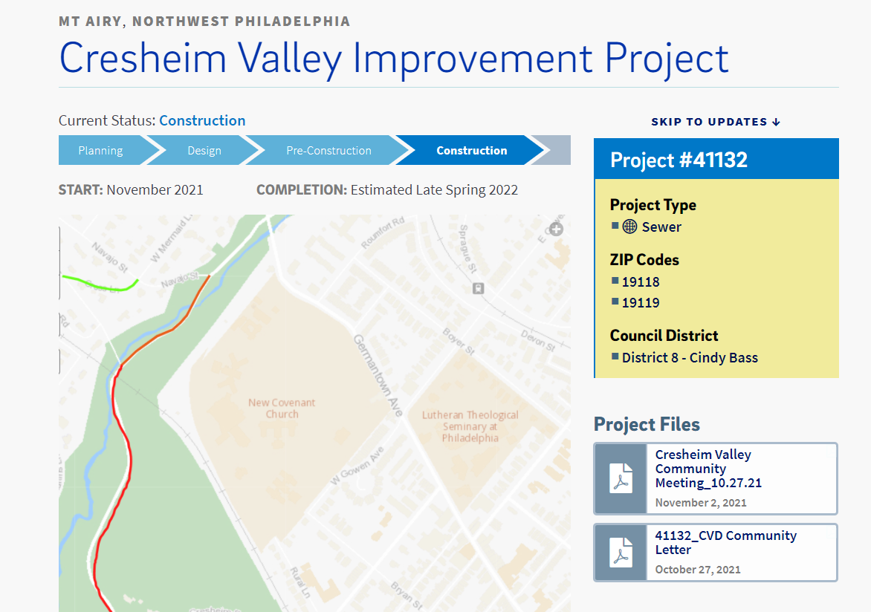
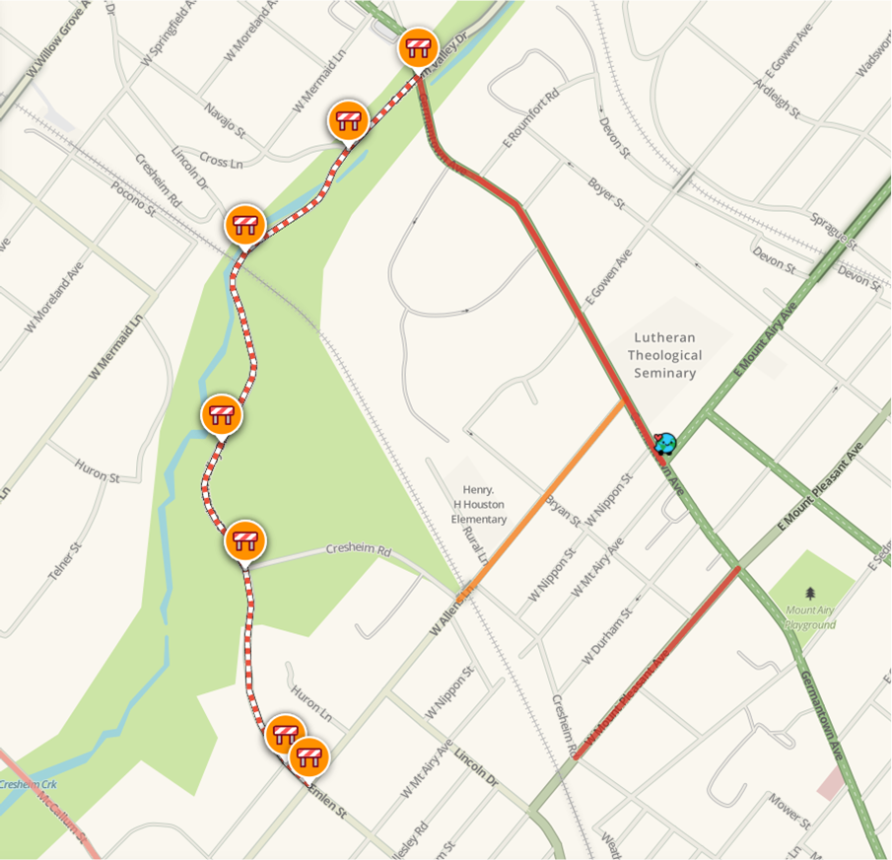
https://water.phila.gov/projects/p41132/
PHILADELPHIA WATER DEPARTMENT | Cresheim Interceptor Capacity Improvement

Slide 14
Thank You!
Questions?

