Slide 1
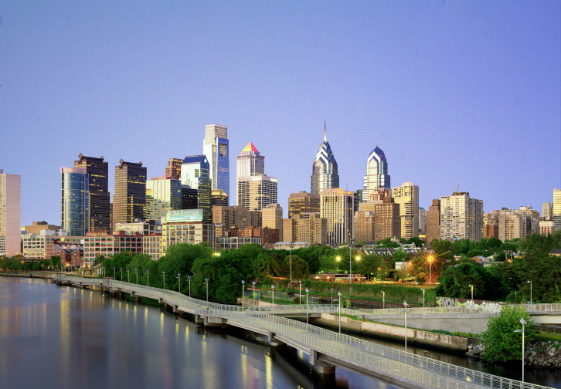
Cresheim Valley Drive Sewer Project
Sewer Reconstruction; PWD Project # S-41132-R
December 2021 Update
Contractor: C. Abbonizio Construction
PWD Construction Engineer: Shyam Thomas

Slide 2
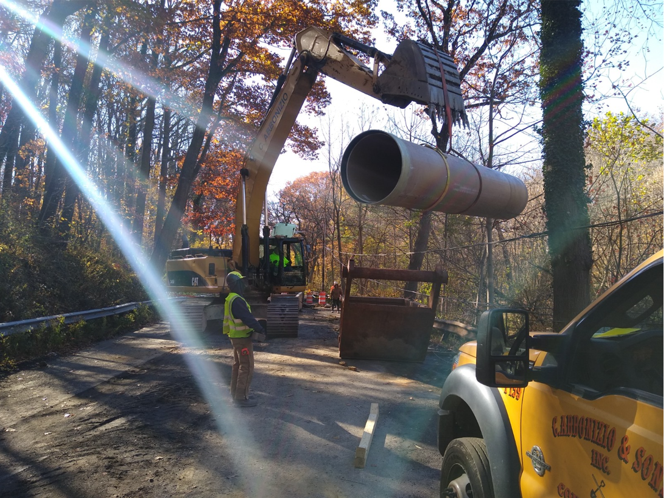
Construction Underway!
PHILADELPHIA WATER DEPARTMENT | Cresheim Interceptor Capacity Improvement

Slide 3
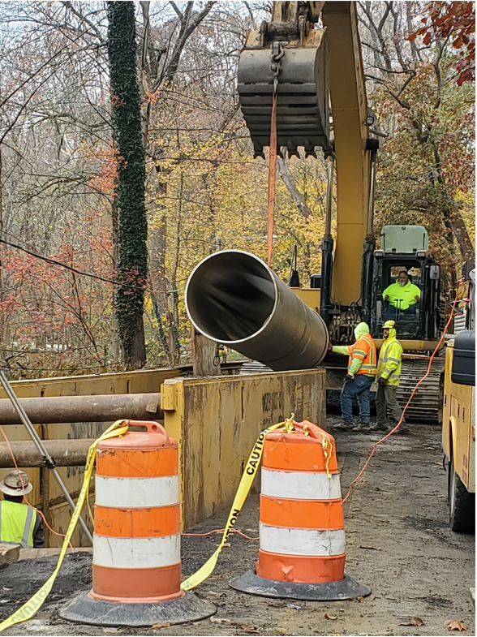
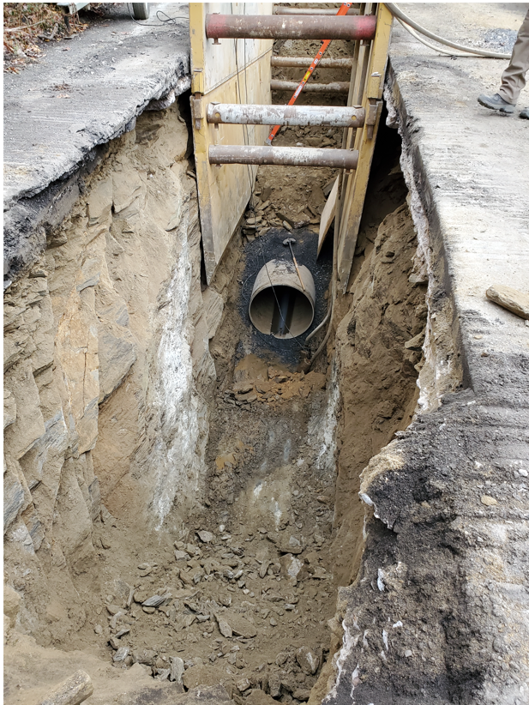

Slide 4
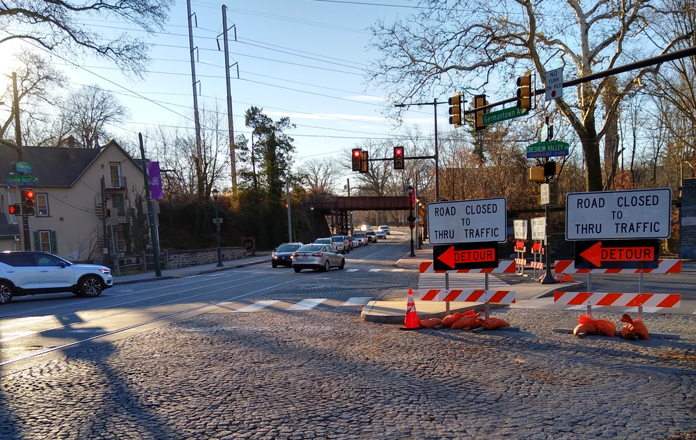
Traffic Detour
PWD Construction Staff Regularly Monitoring Detour Route
Observed Traffic Dispersed Along Alternate Routes
Reports from Residents of Motorists Ignoring Traffic Signs, Driving Dangerously
PHILADELPHIA WATER DEPARTMENT | Cresheim Interceptor Capacity Improvement

Slide 5
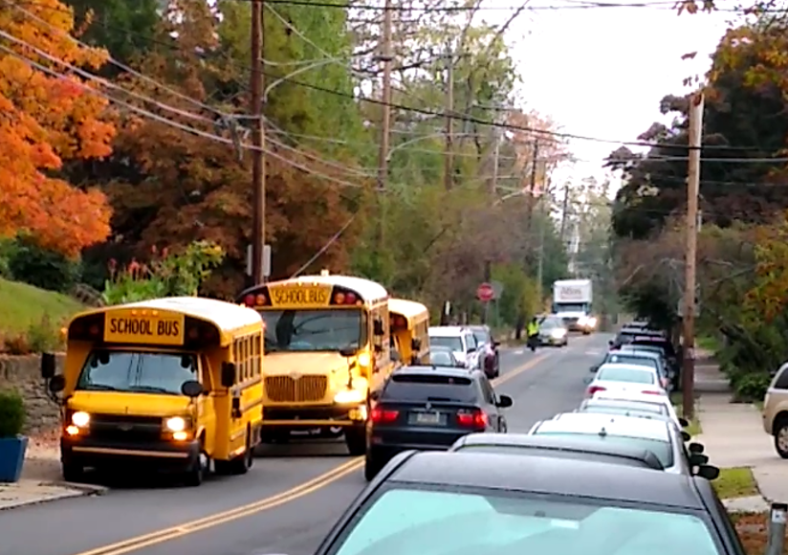
Henry Houston Elementary
Police Presence Provided to Help Ensure Student Safety at Pick-Up and Drop-Off Times
No Safety Incidents Reported To Date
PWD Construction Staff in Regular Correspondence with School Personnel
PHILADELPHIA WATER DEPARTMENT | Cresheim Interceptor Capacity Improvement

Slide 6
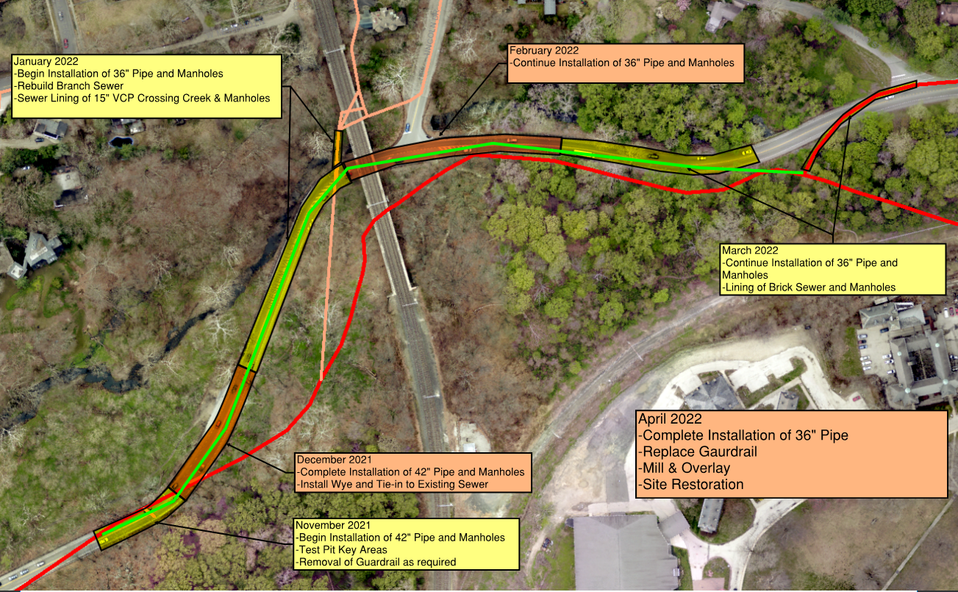
Construction Sequence & Schedule
Progress As of Dec 13th
+ Add’l Roadway Safety Measures
PHILADELPHIA WATER DEPARTMENT | Cresheim Interceptor Capacity Improvement

Slide 7
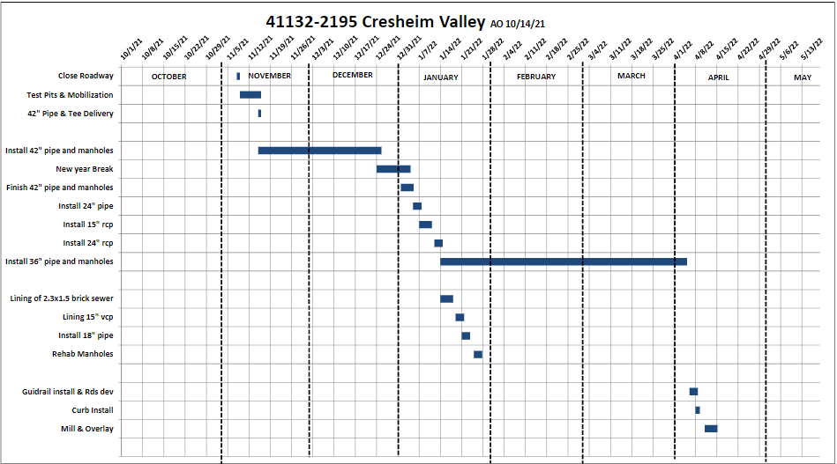
Construction Sequence & Schedule
+ Traffic Safety Improvements

Slide 8
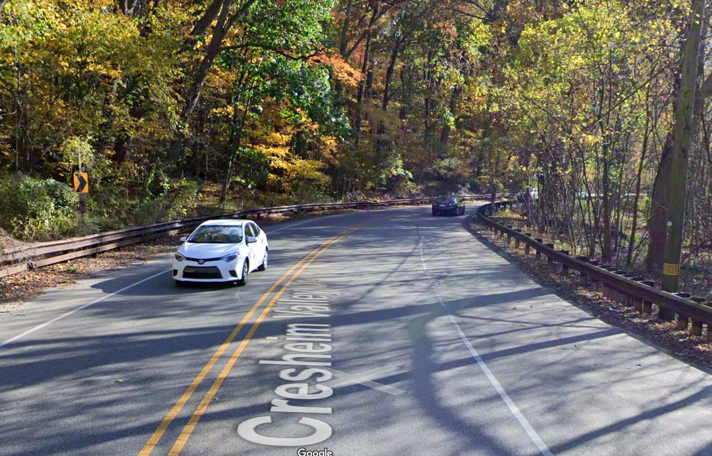
Cresheim Valley Drive - Traffic Safety Improvements
Streets Dept Currently Reviewing Potential for Permanent Traffic Safety Measures
May Include:
Additional Line Striping
Rumble Strips
Recessed Reflectors
PHILADELPHIA WATER DEPARTMENT | Cresheim Interceptor Capacity Improvement
Notes:
Full Closure of Cresheim Valley Drive will be required; PWD does not take this lightly and made several considerations in the project design with intent to minimize duration of the project, and therefore, the impact to the community.
The extent of the excavation and space limitations led us to conclude that the work cannot be undertaken safely without full closure of the road.
Existing traffic conditions are not ideal from a safety perspective and are only exacerbated by construction conditions
Motorist sight lines are limited and cars appear suddenly at many locations on the drive due the sharp curvatures of the road

Slide 9
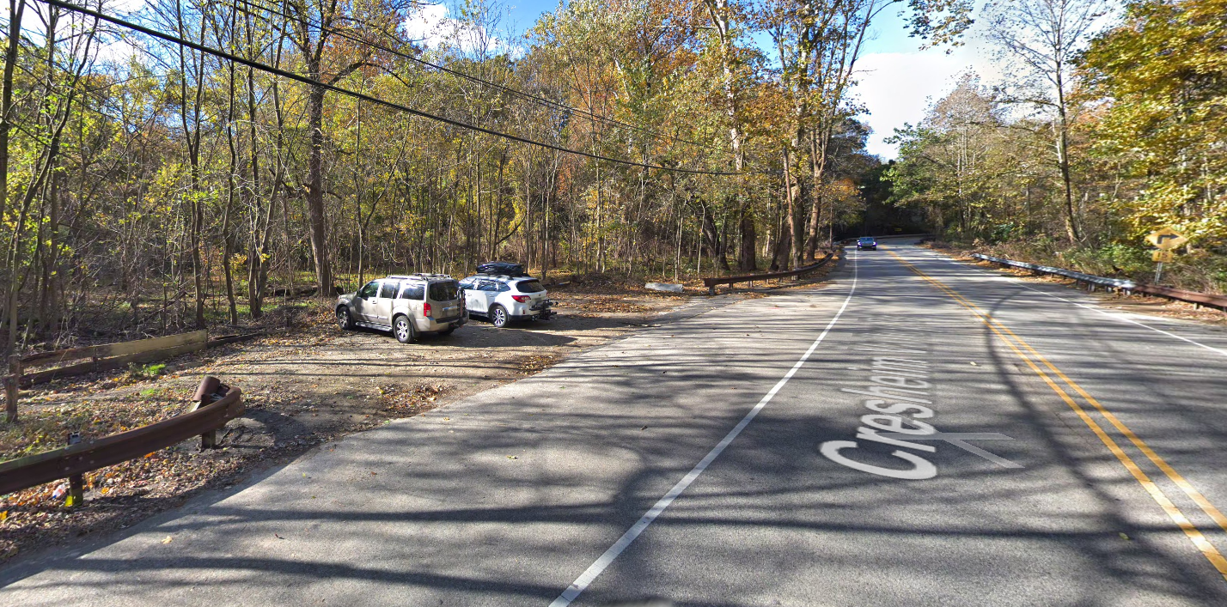
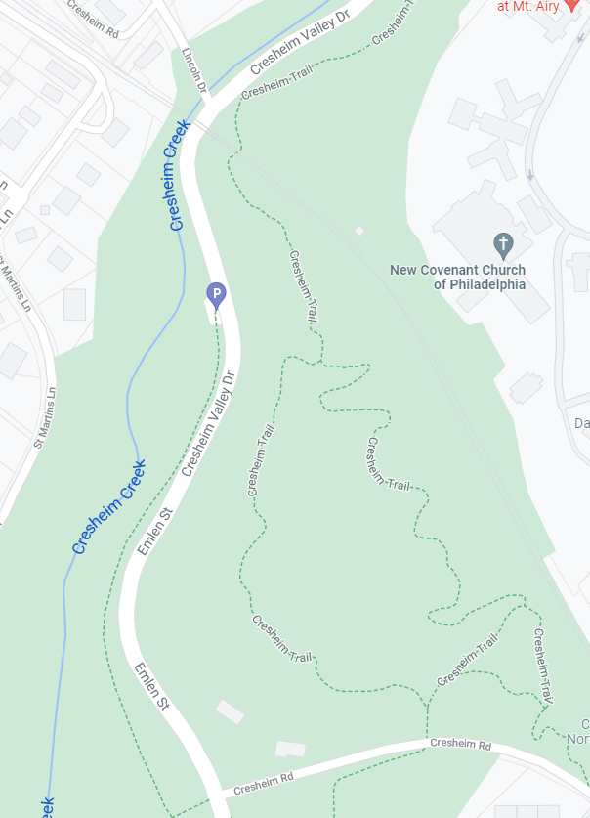
Cresheim Valley Drive - Traffic Safety Improvements
Elimination of Parking Area
Request from Parks Dept; Prevents Illegal Dumping
Removes Dangerous Traffic Configuration
PHILADELPHIA WATER DEPARTMENT | Cresheim Interceptor Capacity Improvement

Slide 10
Thank You!
Questions?

